Slide 1
Precision Interfaces Research Projects

Slide 2
Yiru Chen: Precision Interfaces
Haneen Mohammed: Khameleon
Eugene Wu
https://cudbg.github.io/summer20/

Slide 3
https://cudbg.github.io/summer20/
0 –credit course
2 weeks
Khameleon
Precision Interfaces
weekly
Project 1
Project 2
Project 3
Project 4
slack

Slide 4
https://cudbg.github.io/summer20/
0 –credit course
2 weeks
Section: Precision Interfaces
Section: Khameleon
weekly
Project 1
Project 2
Project 3
Project 4
slack

Slide 5
Slack for communication: wulab2020summer.slack.com
Zoom for meetings: link shared in slack
Weekly Office Hours

Slide 6
Weeks 1-3: Warmup
Tasks and small projects to get familiar with the code
Section meetings to discuss blocking points, share insights, discuss papers
Weeks 4-beyond:
Work on summer projects
Biweekly meetings across both sections as meet and greet.

Slide 7
Section Meetings
Every team will prepare a short presentation (max 5 slides) to share
What the team’s goals were and what has been achieved
Interesting things (parts of the code, a bug, a paper, a related product) that your team has learned
The team’s next steps
Demos, screenshots, storyboards are great!

Slide 8
Goals
gain experience reading research papers
work with a research code base
direct a research project
have an interesting and fun experience

Slide 9
Short Talk about Precision Interfaces (PI)

Slide 10
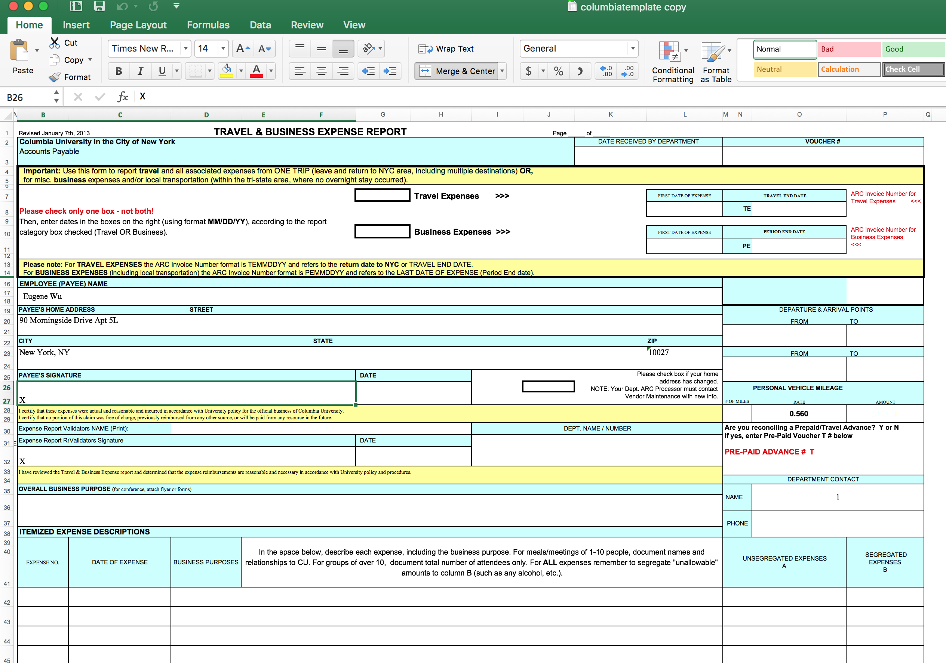
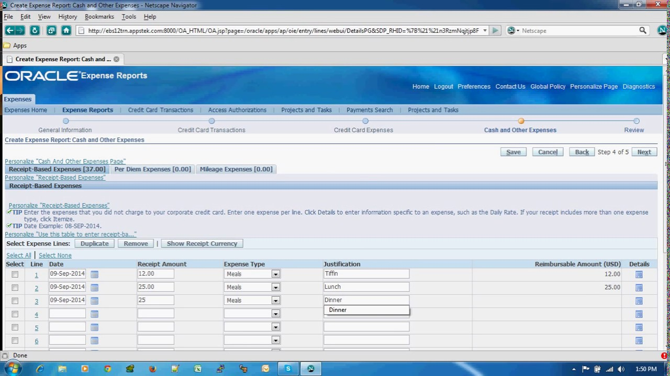
Submitting Expenses
Notes:
submitting expenses at Columbia.
I need to fill out this excel sheet, called a TBER, and email it along with receipts to an admin
No one likes using it. It takes time, its confusing
The same is with other general purpose apps that can ALSO do expense reporting
BUT

Slide 11

Your scientists were so preoccupied with whether Excel could
They didn’t stop to
think if they should
Notes:
Yes. Excel CAN do it
but should it? no it should not

Slide 12

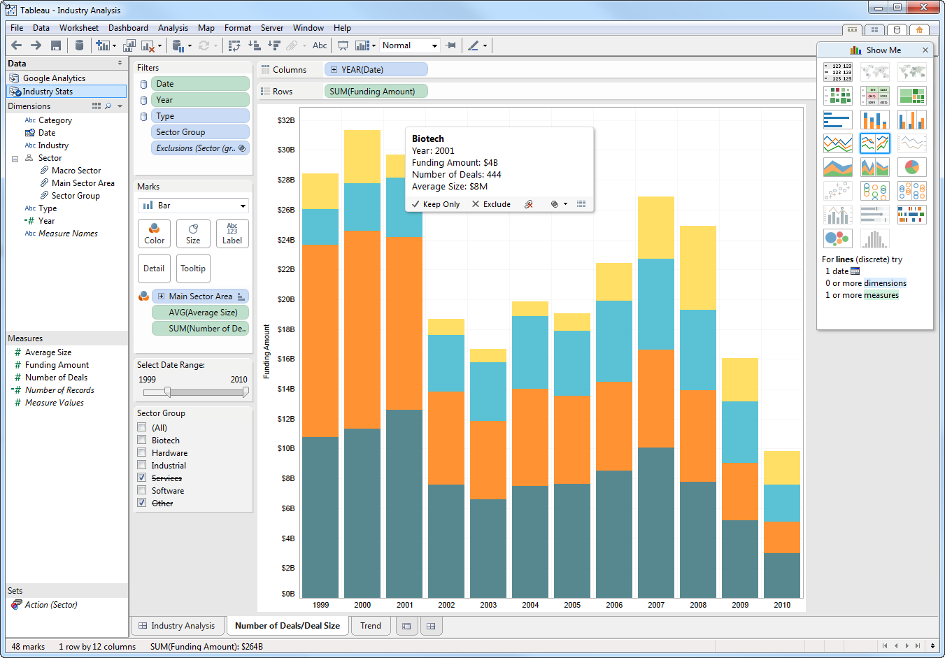
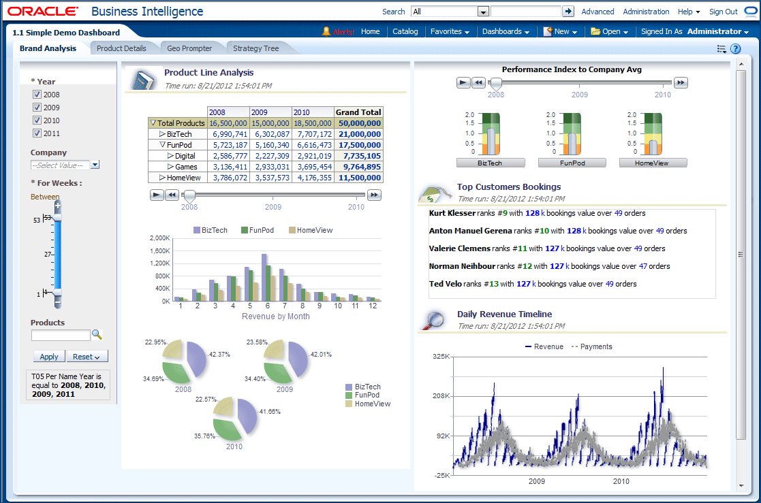
Analyzing Data
SQL
SELECT NAME,UCD FROM DBCOLUMNS WHERE TABLENAME = 'PHOTOOBJALL' AND ( NAME LIKE 'OBJID' OR NAME LIKE 'RA' OR NAME LIKE 'DEC' OR NAME LIKE 'TYPE' OR NAME LIKE 'U' OR NAME LIKE 'G' OR NAME LIKE 'R' OR NAME LIKE 'I' OR NAME LIKE 'Z' OR NAME LIKE 'ERR_U' OR NAME LIKE 'ERR_G' OR NAME LIKE 'ERR_R' OR NAME LIKE 'ERR_I' OR NAME LIKE 'ERR_Z' OR NAME LIKE 'PSFMAG_U' OR NAME LIKE 'PSFMAGERR_U' OR NAME LIKE 'PSFMAG_G' OR NAME LIKE 'PSFMAGERR_G' OR NAME LIKE 'PSFMAG_R' OR NAME LIKE 'PSFMAGERR_R' OR NAME LIKE 'PSFMAG_I' OR NAME LIKE 'PSFMAGERR_I' OR NAME LIKE 'PSFMAG_Z' OR NAME LIKE 'PSFMAGERR_Z')
Users Conform to the Interface
Notes:
And this is the case with analyzing data
The dominant ways, such as SQL, or Tableau, or a BI tool are wholly overpowered, or designed for something else altogether
users CONFORM to generic applications
But if we look at mobile, or the web

Slide 13

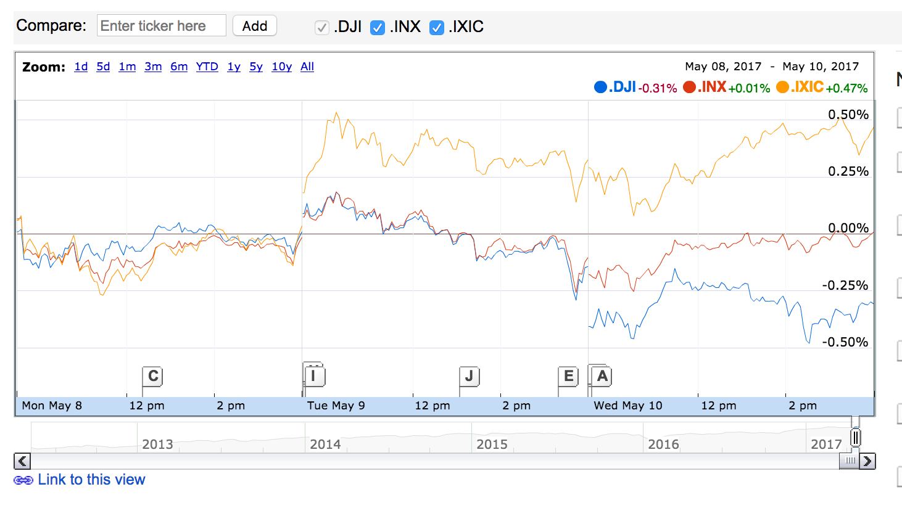
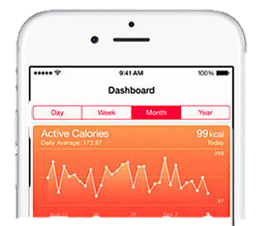
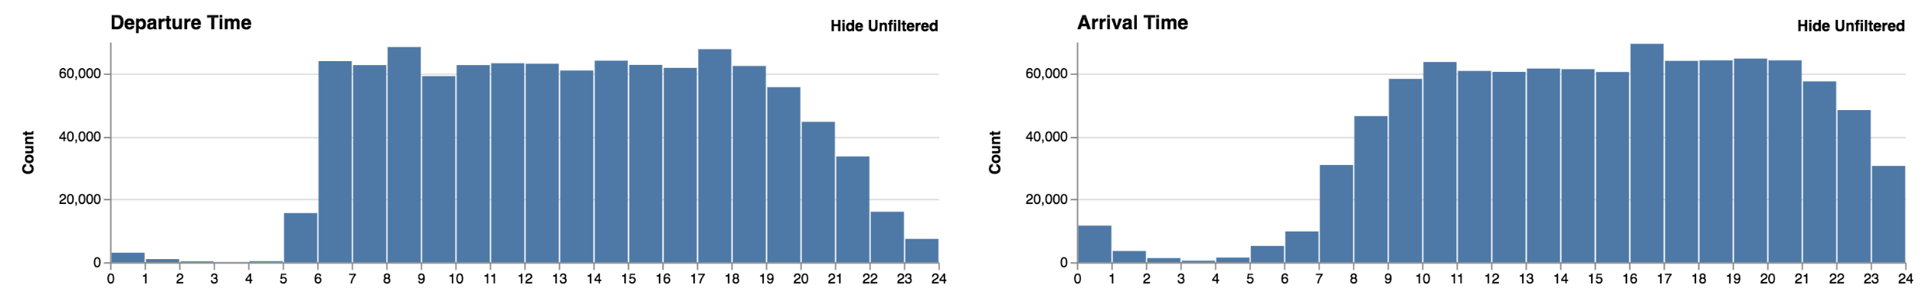
Interfaces Customized to the Task
Notes:
when interfaces are customized to the task
Instead of Excel, Expensify lets you take a photo of the receipt, and everything else happens automatically
Instead of using photoshop, there are dozens of photo filtering apps
This is the power of customized interfaces
Does it spark joy? thank you marie kondo. yes it does.
So if we want an interface customized to our analysis task, what options do we have?

Slide 14



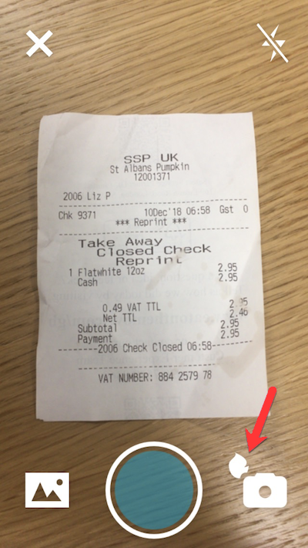
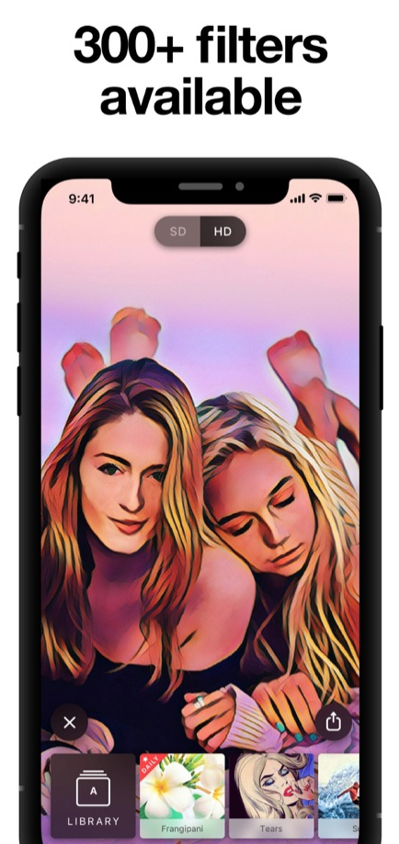
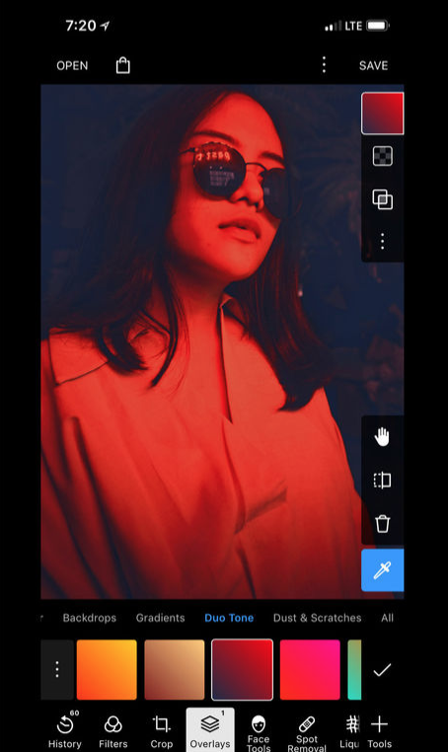
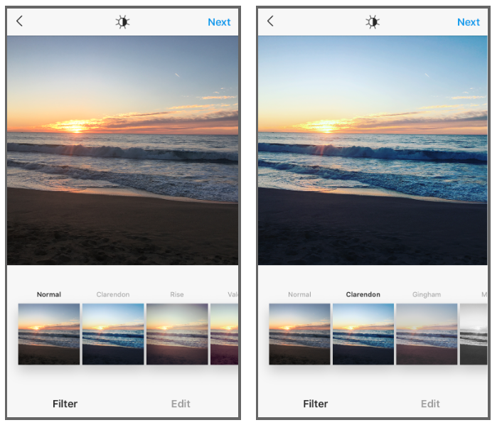
Interfaces Customized to the Task
Notes:
when interfaces are customized to the task
Instead of Excel, Expensify lets you take a photo of the receipt, and everything else happens automatically
Instead of using photoshop, there are dozens of photo filtering apps
This is the power of customized interfaces
Does it spark joy? thank you marie kondo. yes it does.
So if we want an interface customized to our analysis task, what options do we have?

Slide 15
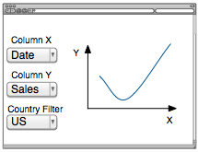

Option 1: Pay to Build Interface
Costs $$$, engineers, time
Specs
Build Interface
Notes:
Pay, with money, or time to gather the specs and develop an interface.
But rain isn’t in the forecast

Slide 16
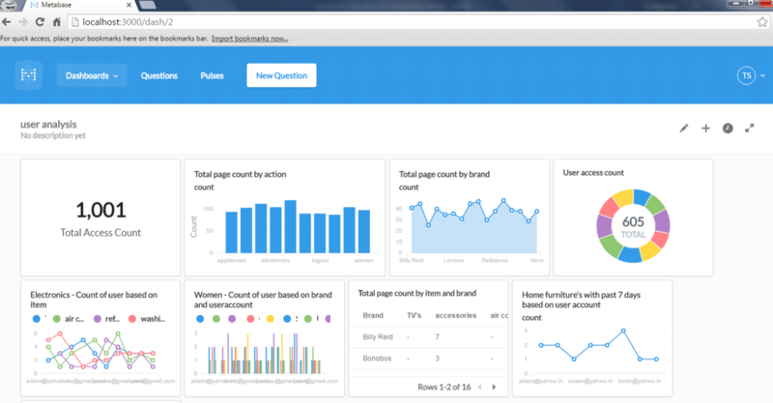
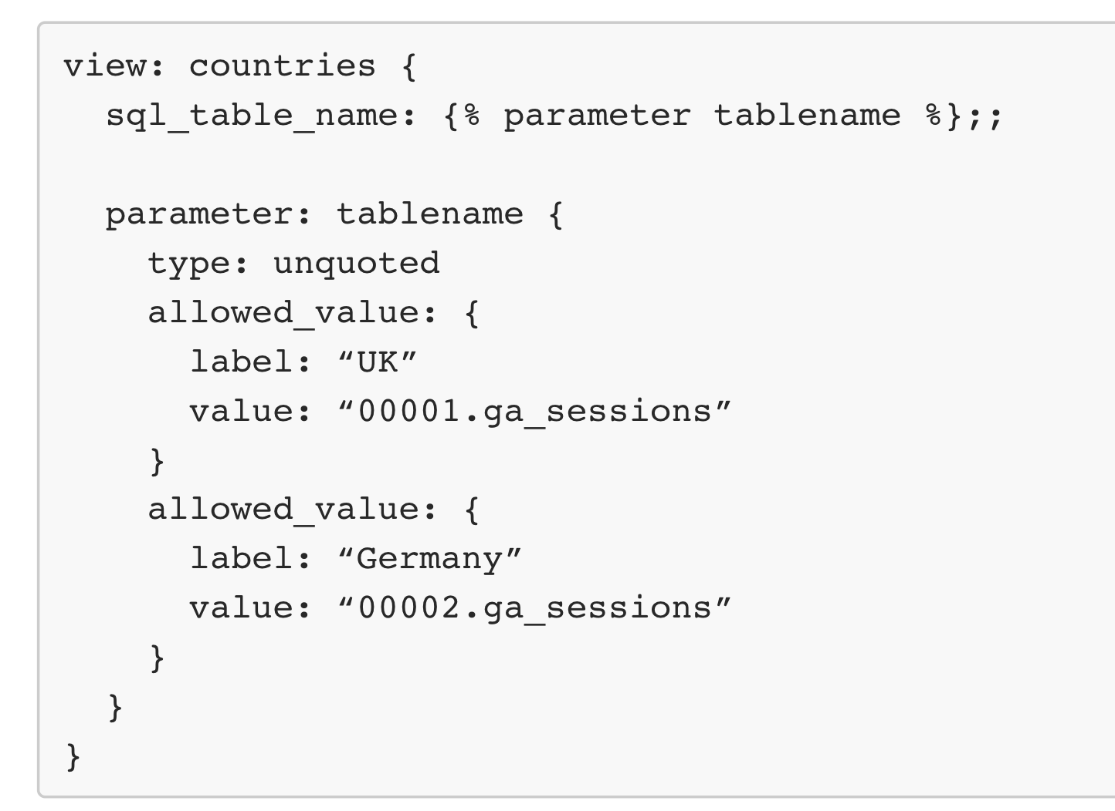
Option 2: Use Dashboard Builder
Upper limit on analysis complexity/hard to use
Analysis Task
Build Interface
Metabase, Looker
Notes:
the end user knows her task, and uses a dashboard builder
however the builders are typically pre-canned to keep the interface simple, or basically resort to visual or real programming

Slide 17
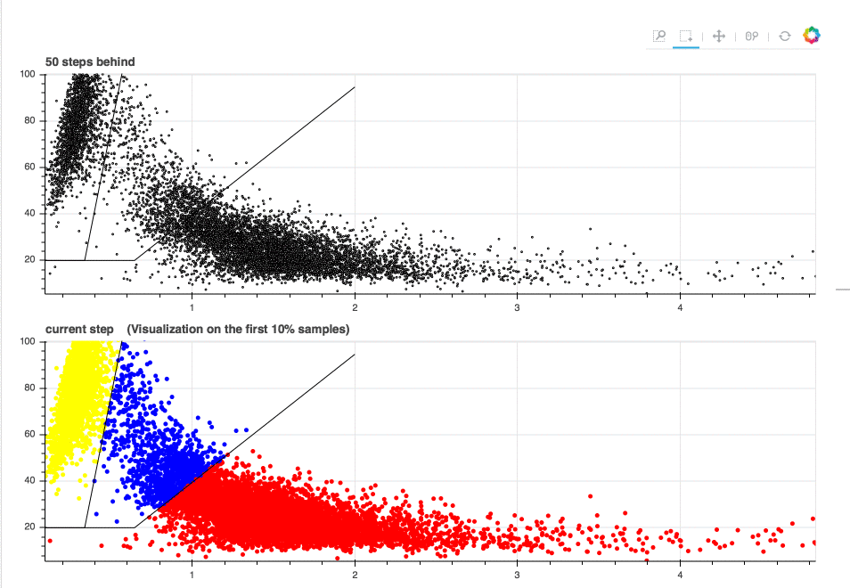
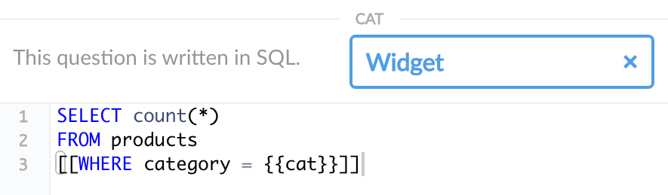

Slide 18
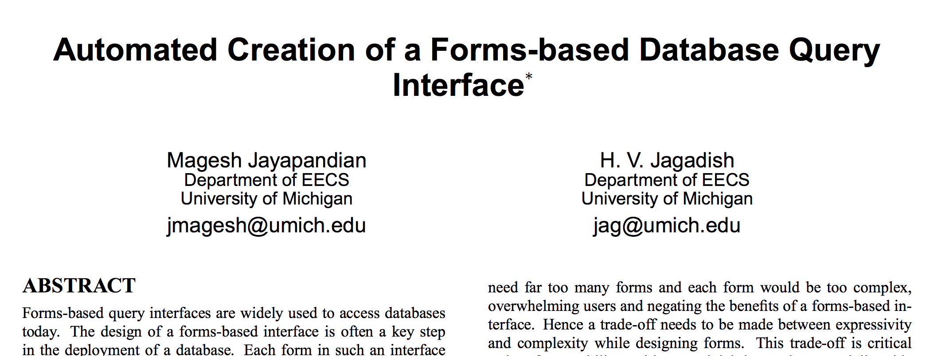
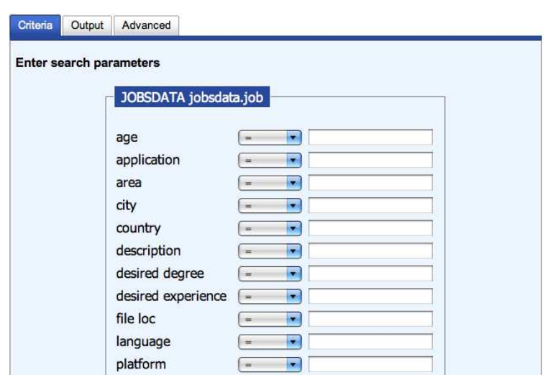
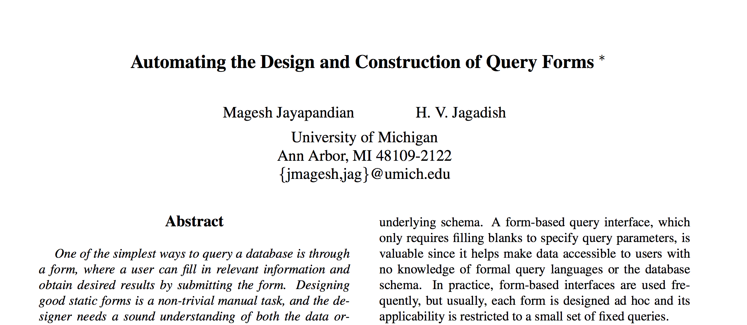
Option 3: Generate using Database
Search/CRUD interfaces. Not analysis-specific
SDSS:100+ tables, 60+ attrs/table
Data
Gen. Form
Notes:
ideally, we could automatically generate an interface.
and work from jag and others generates search and CRUD interfaces (like on the right) solely using schema and data.
but they are not designed for analytics, and don’t leverage analysis information.

Slide 19
Option 4: Vis Recommendation
Focus is on presentation and simple transforms
Data/Vis
Recommend Vis
Notes:
Complementary to us is vis recommendation using data or previous visualizations. But they focus on presentation, and not

Slide 20
Option 4: Vis Recommendation
Focus is on presentation and simple transforms
Data/Vis
Recommend Vis
But not this
Notes:
interaction controls.

Slide 21
Idea
Use analysis task to generate analysis interface
Analysis Task
Gen. Interface
Notes:
For these reasons, our great idea is to use the analysis to auto generate an analysis interface
where do we get the task?

Slide 22
Idea
Use analysis task to generate analysis interface
Read Minds
Gen. Interface
Notes:
well we could try to use brain computer interfaces to read minds

Slide 23


Idea
Use analysis task to generate analysis interface
Read Minds
Gen. Interface
Notes:
but it is... messy

Slide 24


Idea
Use query logs to generate analysis interface
Analyze Logs
Gen. Interface
Jupyter Notebooks
Recovery logs
Provenance everywhere e.g.,
Any database app

Slide 25
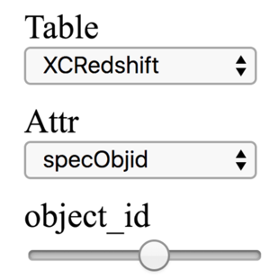
Precision Interfaces Contribution
Unifying Model across Queries and Interactive Interfaces
Syntactic approach
select * from SpecLineIndex where specObjId=0x0189ca525d400000
select * from XCRedshift where specObjId=0x021bcb319ec00000
select * from SpecLineIndex where specObjId=0x019bca6905000000
select * from Field where fieldId=0x08140415c0740000
select * from Frame where fieldId=0x081505b6c07f0000
select * from SpecObjAll where specObjId=0x021bcb311d800000
select * from PhotoZ where objId=0x08140415c0740004
?
Notes:
Only need language grammar
Works when analyses are repetitive
Independent of query complexity
Generate simple interactive controls

Slide 26
Precision Interfaces Overview
Notes:
we decompose this into two steps, mining interactions from the log, and selecting the widgets from these interactions.
I’ll walk through the main ideas in this pipeline.

Slide 27
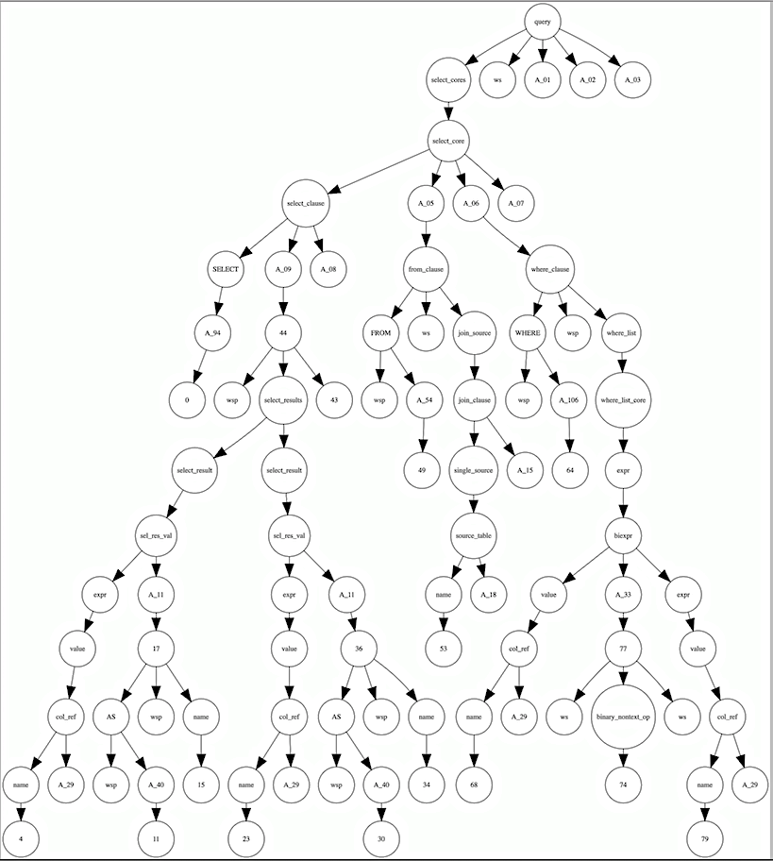
Queries as ASTs
Queries modeled as Abstract Syntax Trees
q₁:avg(a)
q₂:count(b)
SELECT date as x,
sales as y
FROM sales
WHERE cty = USA
func
func
avg
a
count
b
Notes:
Instead of modeling queries as strings, such as these toy expressions, we use parse trees instead.
This encodes the query structure and avoids alignment issues such as whitespace
For instance, this is the parse tree of a simple SQL query

Slide 28
Interactions as Query Transforms
Mine for interactions in log
q₁:avg(a)
q₂:count(b)
func
func
avg
a
count
b
Notes:
Interaction mining looks for AST transformations that the widgets will need to express.
Here we could
Swap the whole tree at the root,
or individually swap avg to count, and a to b.

Slide 29
Interactions as Query Transforms
Mine for interactions in log
q₁:avg(a)
q₂:count(b)
func
func
+ { $0: 0, $1: 0 } =
ANY:$0
ANY:$1
avg
a
avg
count
a
b
difftree
Notes:
Interaction mining looks for AST transformations that the widgets will need to express.
Here we could
Swap the whole tree at the root,
or individually swap avg to count, and a to b.

Slide 30
Widgets (views) as Choices
Widgets as sets of subtrees w/ same path
Dropdown(/1/, {a, b, c})
func
func
ANY:$0
ANY:$1
a
avg
count
a
b
c
b
c
Notes:
We model widgets by the set of subtrees that can be replace at the same path – essentially sets of edges in the graph
For example, the function argument may vary by a, b, c, and a dropdown can be instantiated by the path /1/, and the three options

Slide 31
Widgets (views) as Choice Nodes
Widgets as sets of subtrees w/ same path
Dropdown(/1/, {a, b, c})
func
func
ANY:$0
ANY:$1
User choice changes
the path /1/
to subtree
a
avg
count
a
b
c
b
a
c

Slide 32
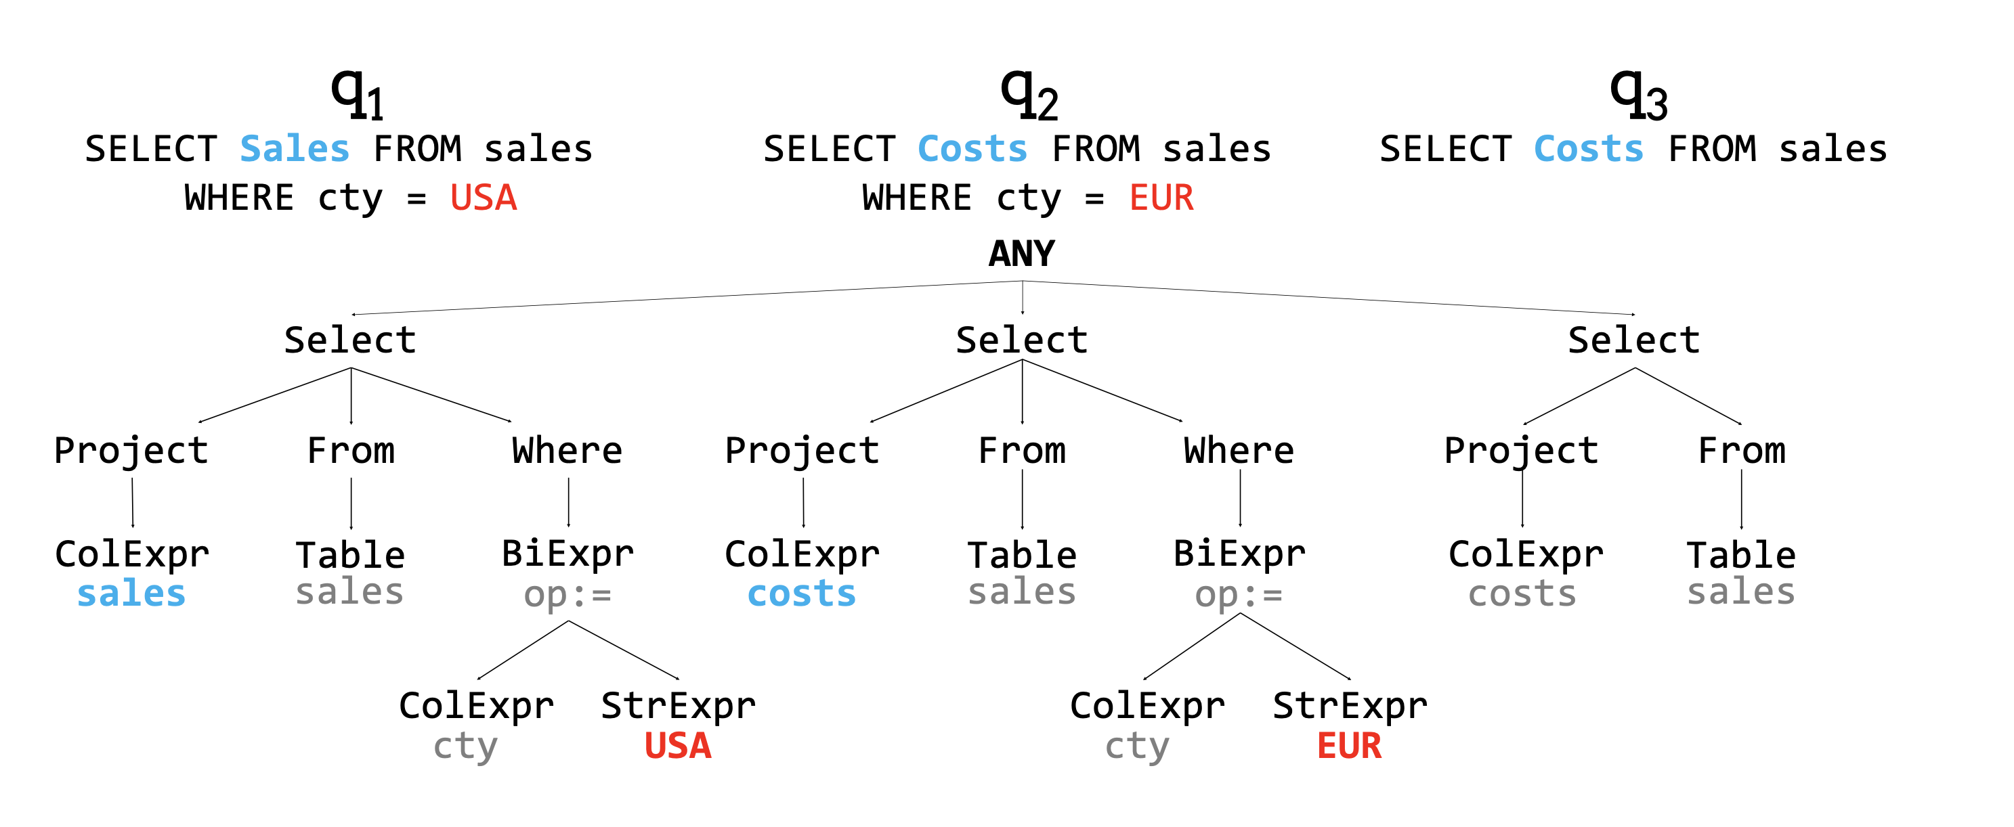

Slide 33
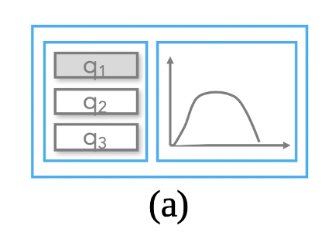
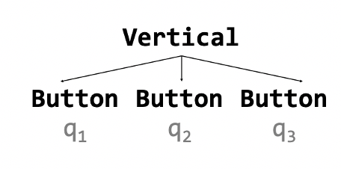

Slide 34
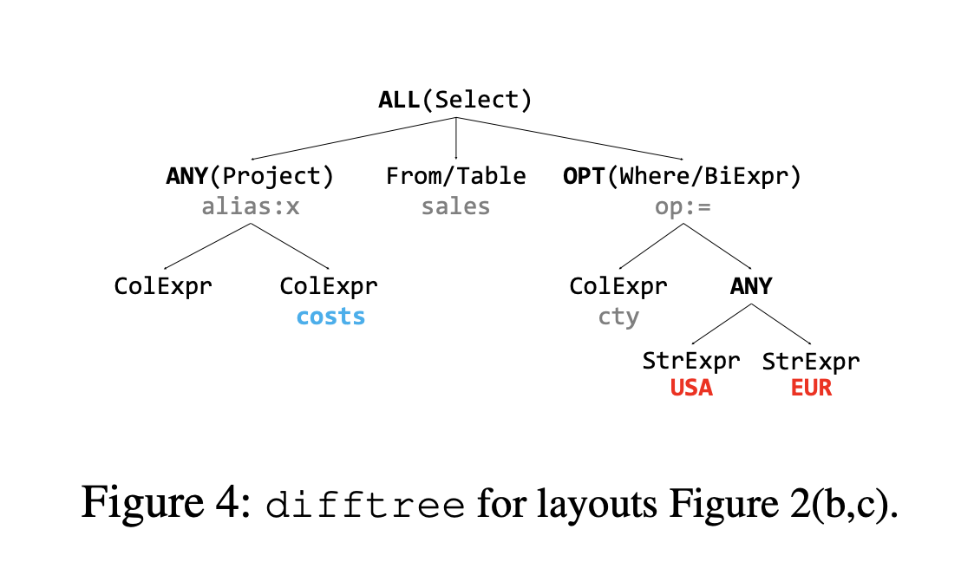
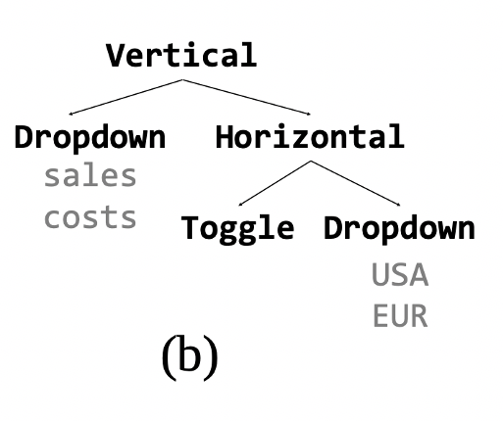
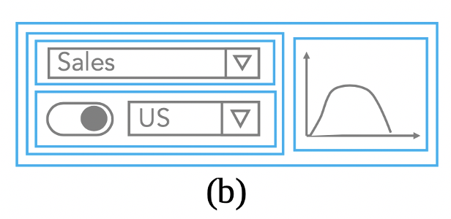

Slide 35
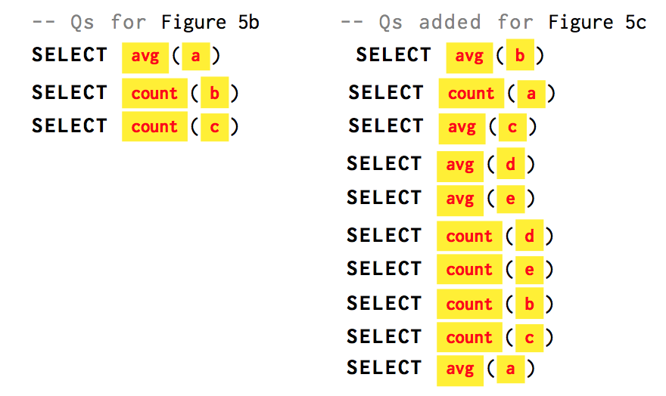
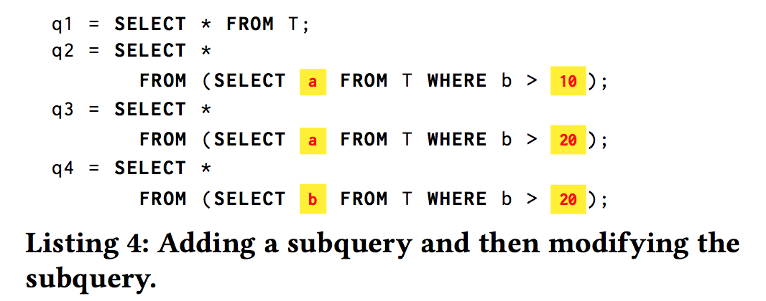
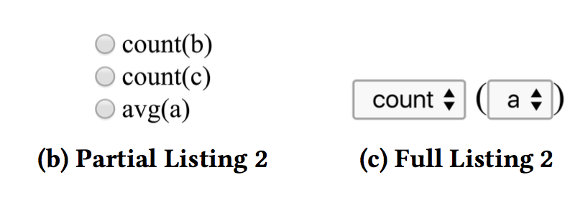
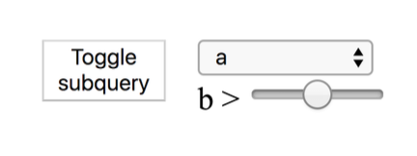
Notes:
select t, nox from air
select t, nox from air where day = 14.0
select t, temp from air where day = 14.0
ok, I’m not done, and I can throw this interface away, or let someone else us it
select t, temp from (SELECT * from air as air2 where co < 0) where day = 14.0

Slide 36
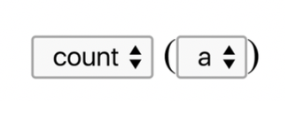
Precision Interfaces

Slide 37
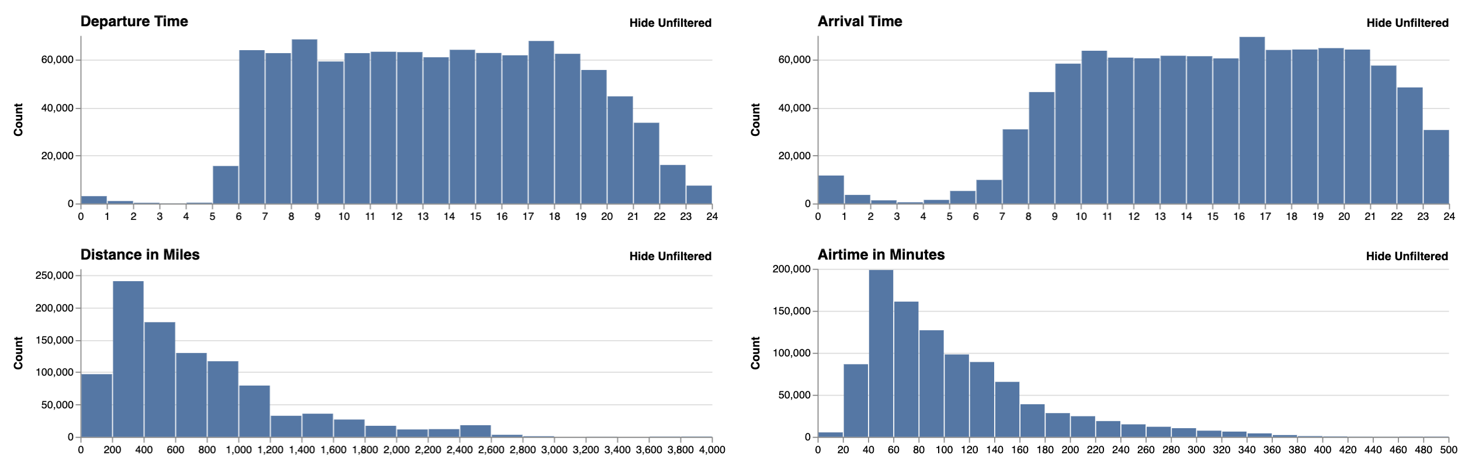
Precision Interfaces

Slide 38
Front-end Engine
Precision Interfaces
Interface Specification
Back-end Server

Slide 39
PI-client
Precision Interfaces
Interface Specification
PI-server

Slide 40
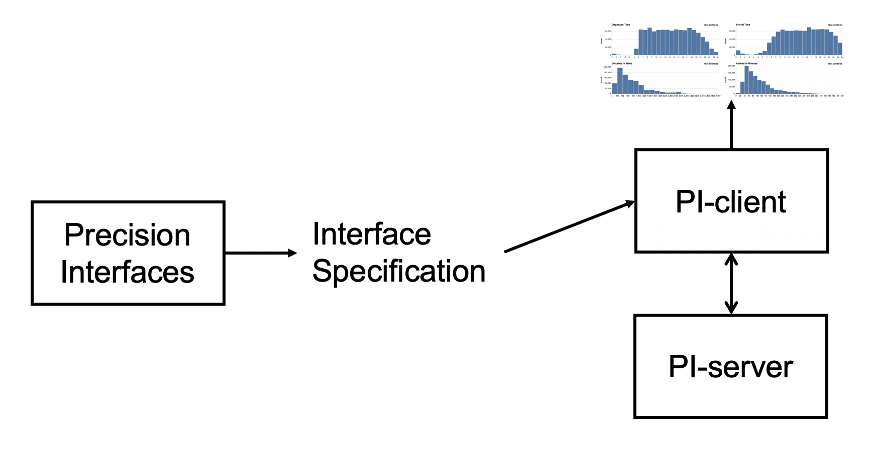

Slide 41
Jeffrey: any day 9am est – 6pm est
Guanjie: NO RESTRICTONS
Sam: Australia time
Monday 5PM section meetings
Yiru
Homework:

